Slide 1
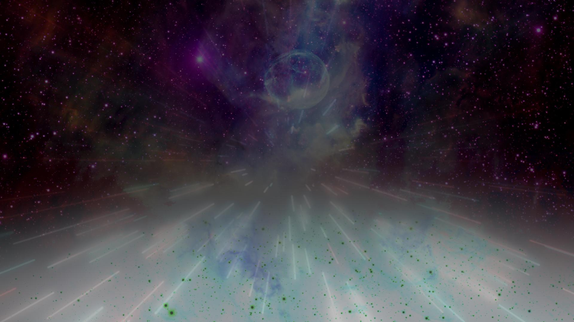















Lindsey Tober
Mentor: Dr. Eric Stribling
NASA Space Grant Symposium
April 20, 2024

Slide 2
Project Overview
Problem: Space technical designs have unintended consequences for different societal stakeholders.
Objective: Create a YouTube channel dedicated to creating awareness about the importance of space technologies in daily life and issues central to ethical and inclusive space design.

Slide 3
Methods
Choose Technology
Research
Write Script
Shoot Videos
Edit Videos
Create Thumb-nails
Peer Review Videos
Publish Videos

Slide 4
Choose Technology & Research
Based on research conducted by ASU’s Space Exploration and Sustainable Development Project
Student led research
Engaged industry experts
Take big issues and make them approachable

Slide 5
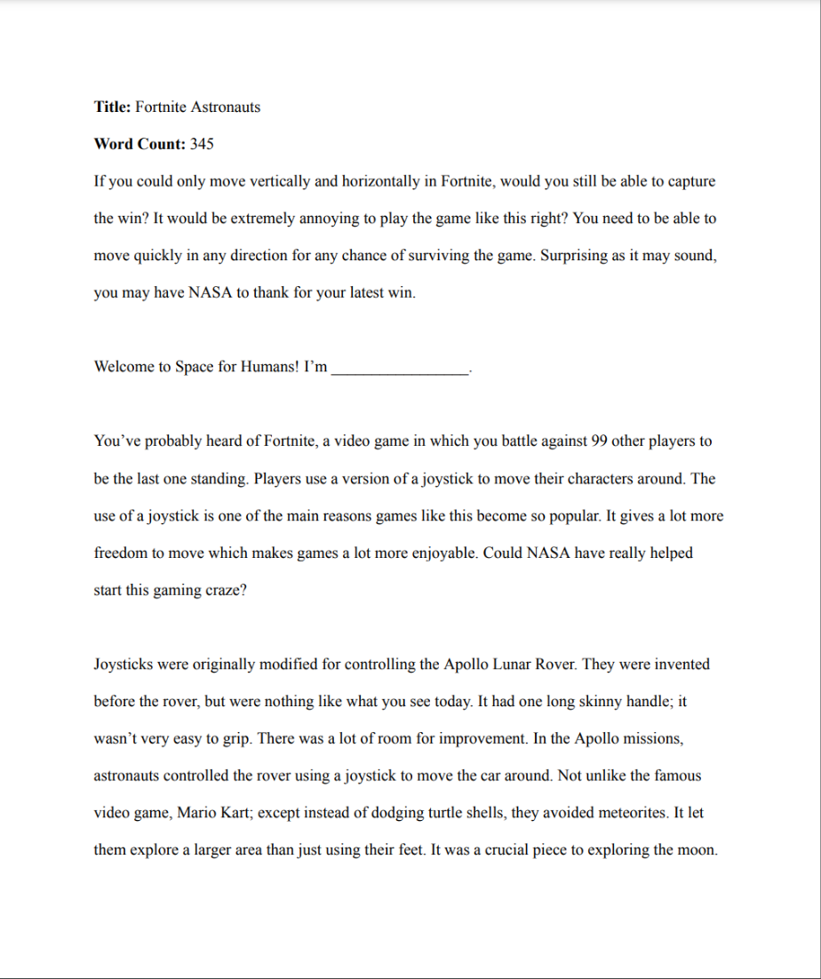
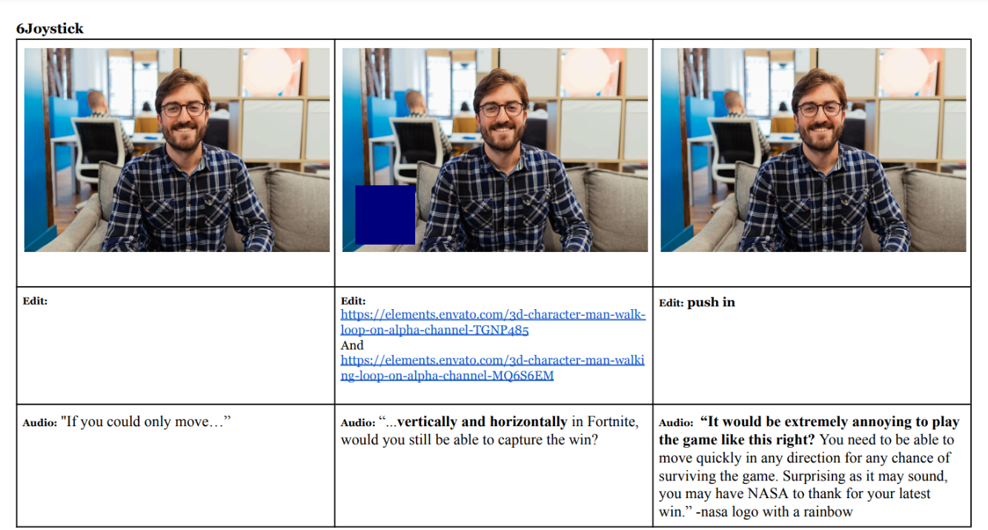
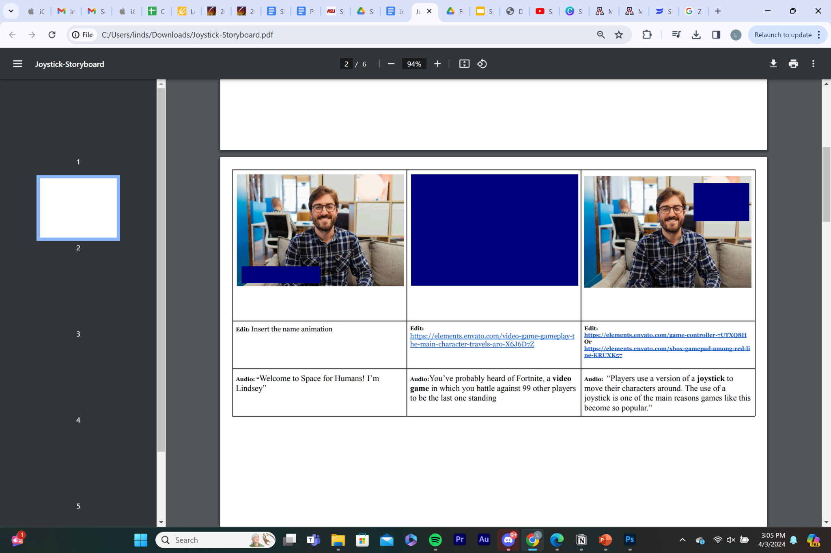
Write Script
Notes:
-work with Amanda Kehrberg

Slide 6
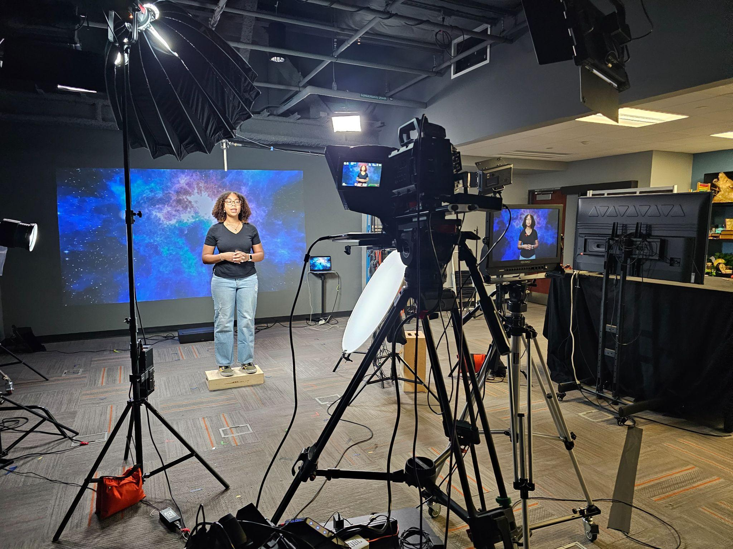
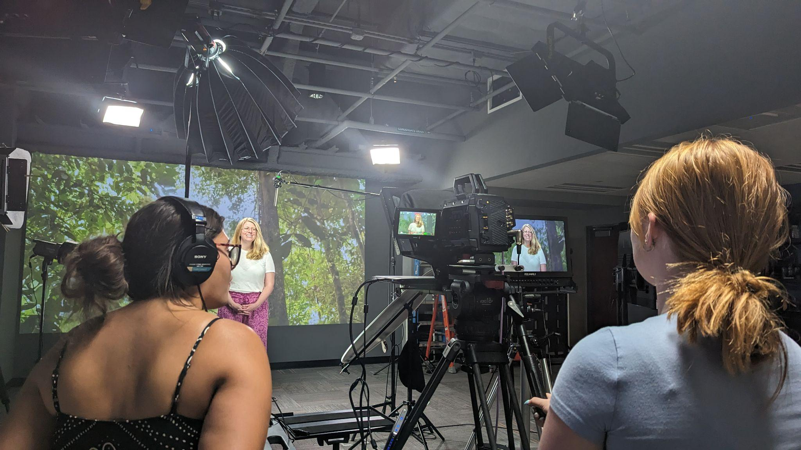
Shoot Videos
Notes:
Set up equipment
Teleprompter
Ran camera and audio
Directed
PA

Slide 7
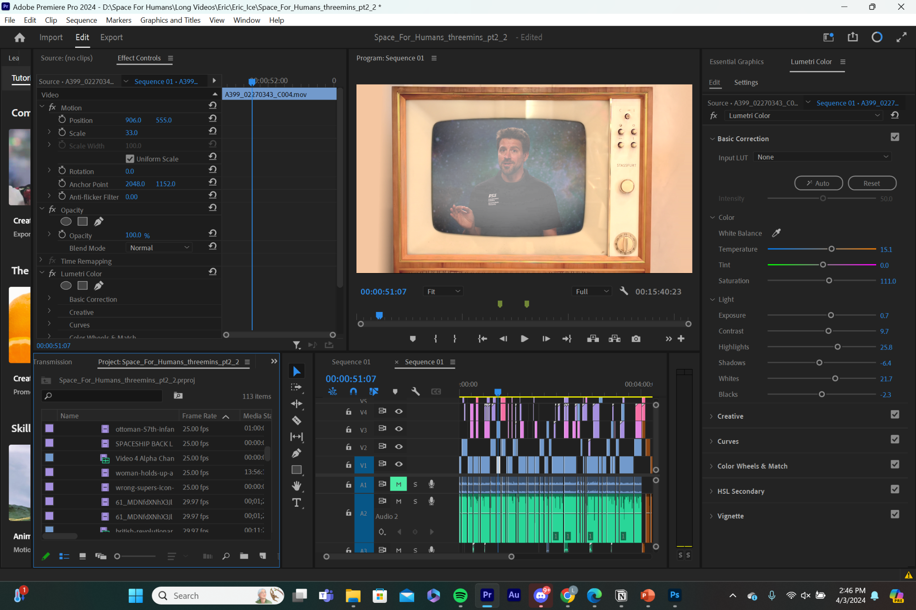
Edit Videos
Notes:
-isabelle Giunter and Ricardo Leon taught me
-I am profefficiant
-I teach other people and will continue to teach others

Slide 8
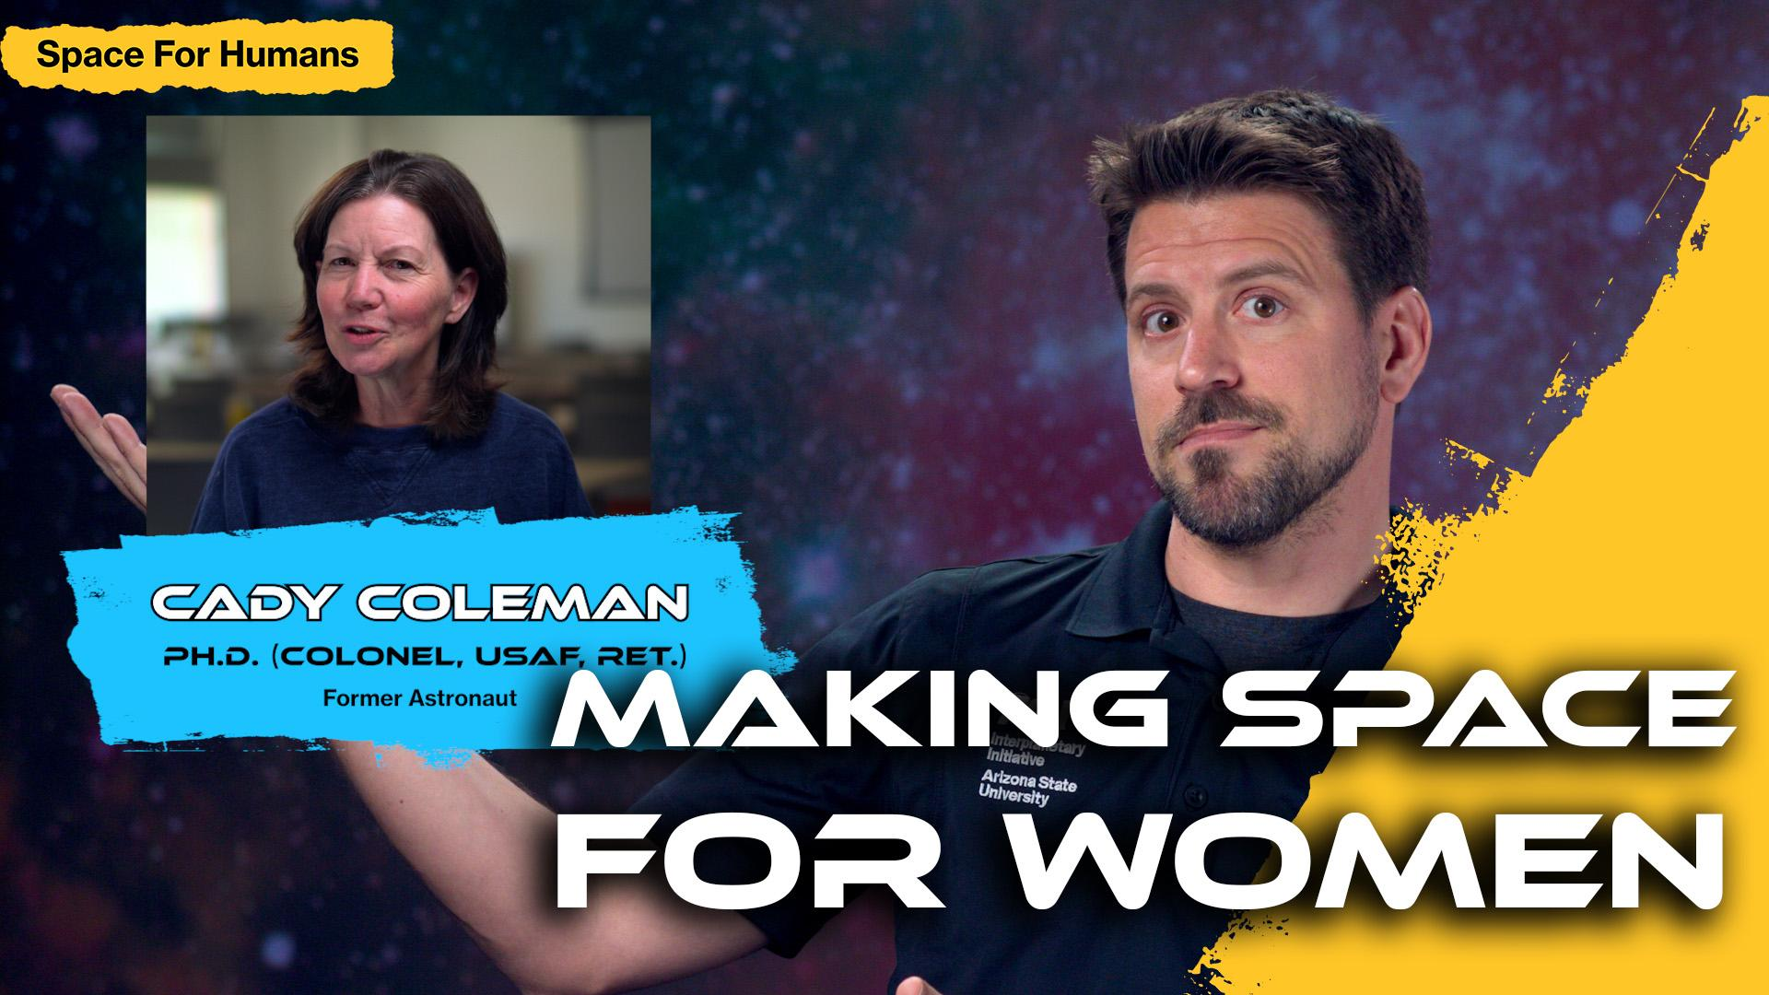
Create Thumbnails
Notes:
-Ricardo Leon designs these

Slide 9
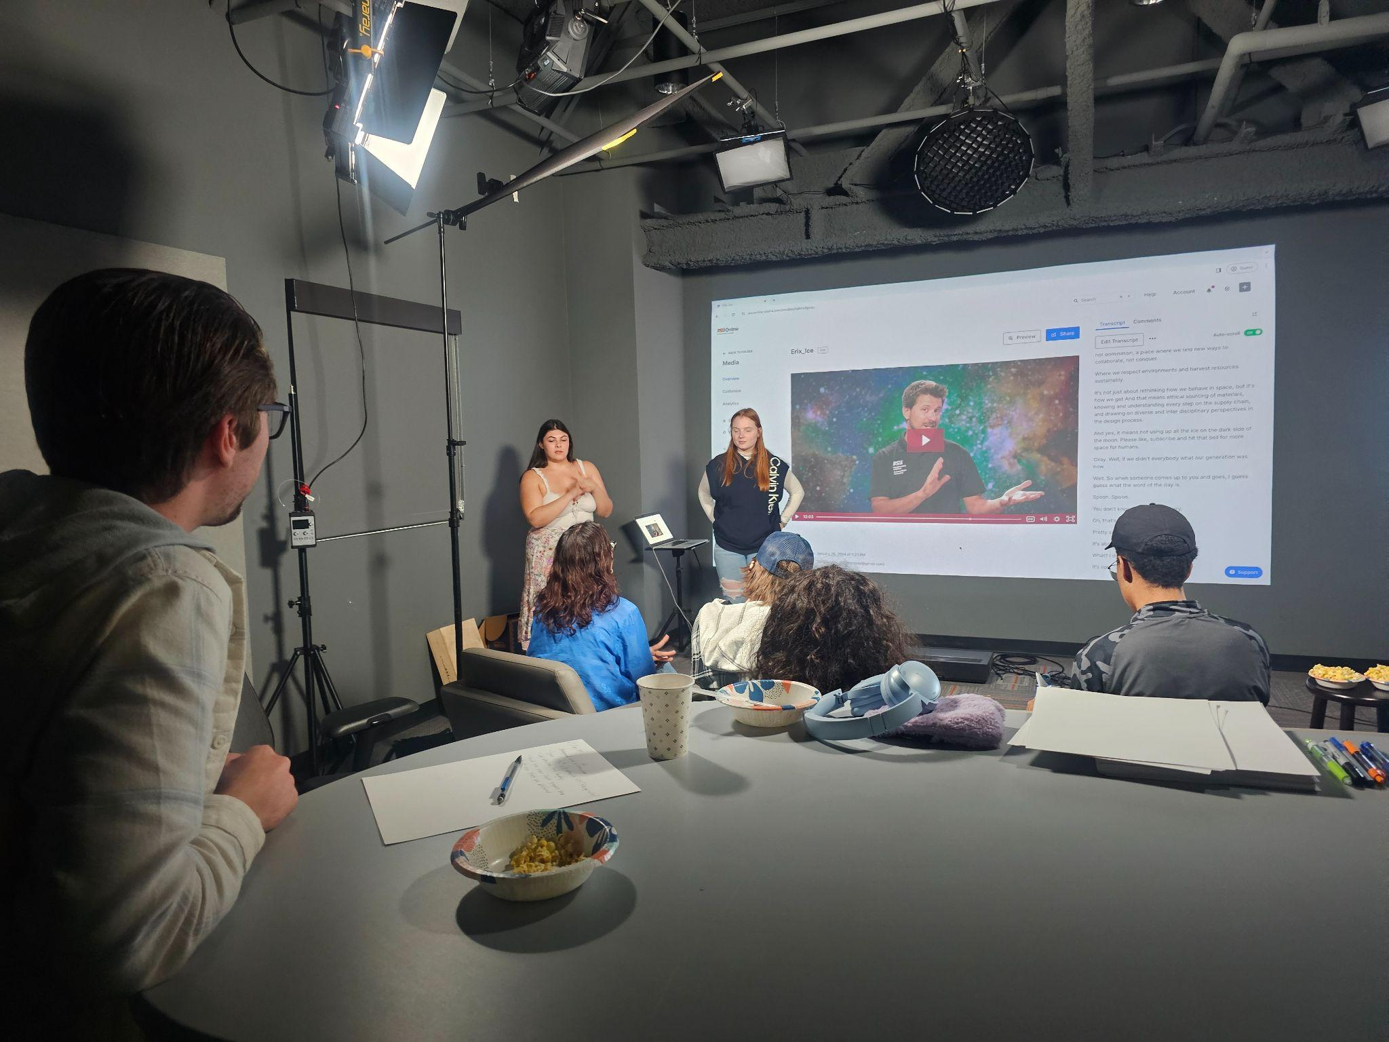
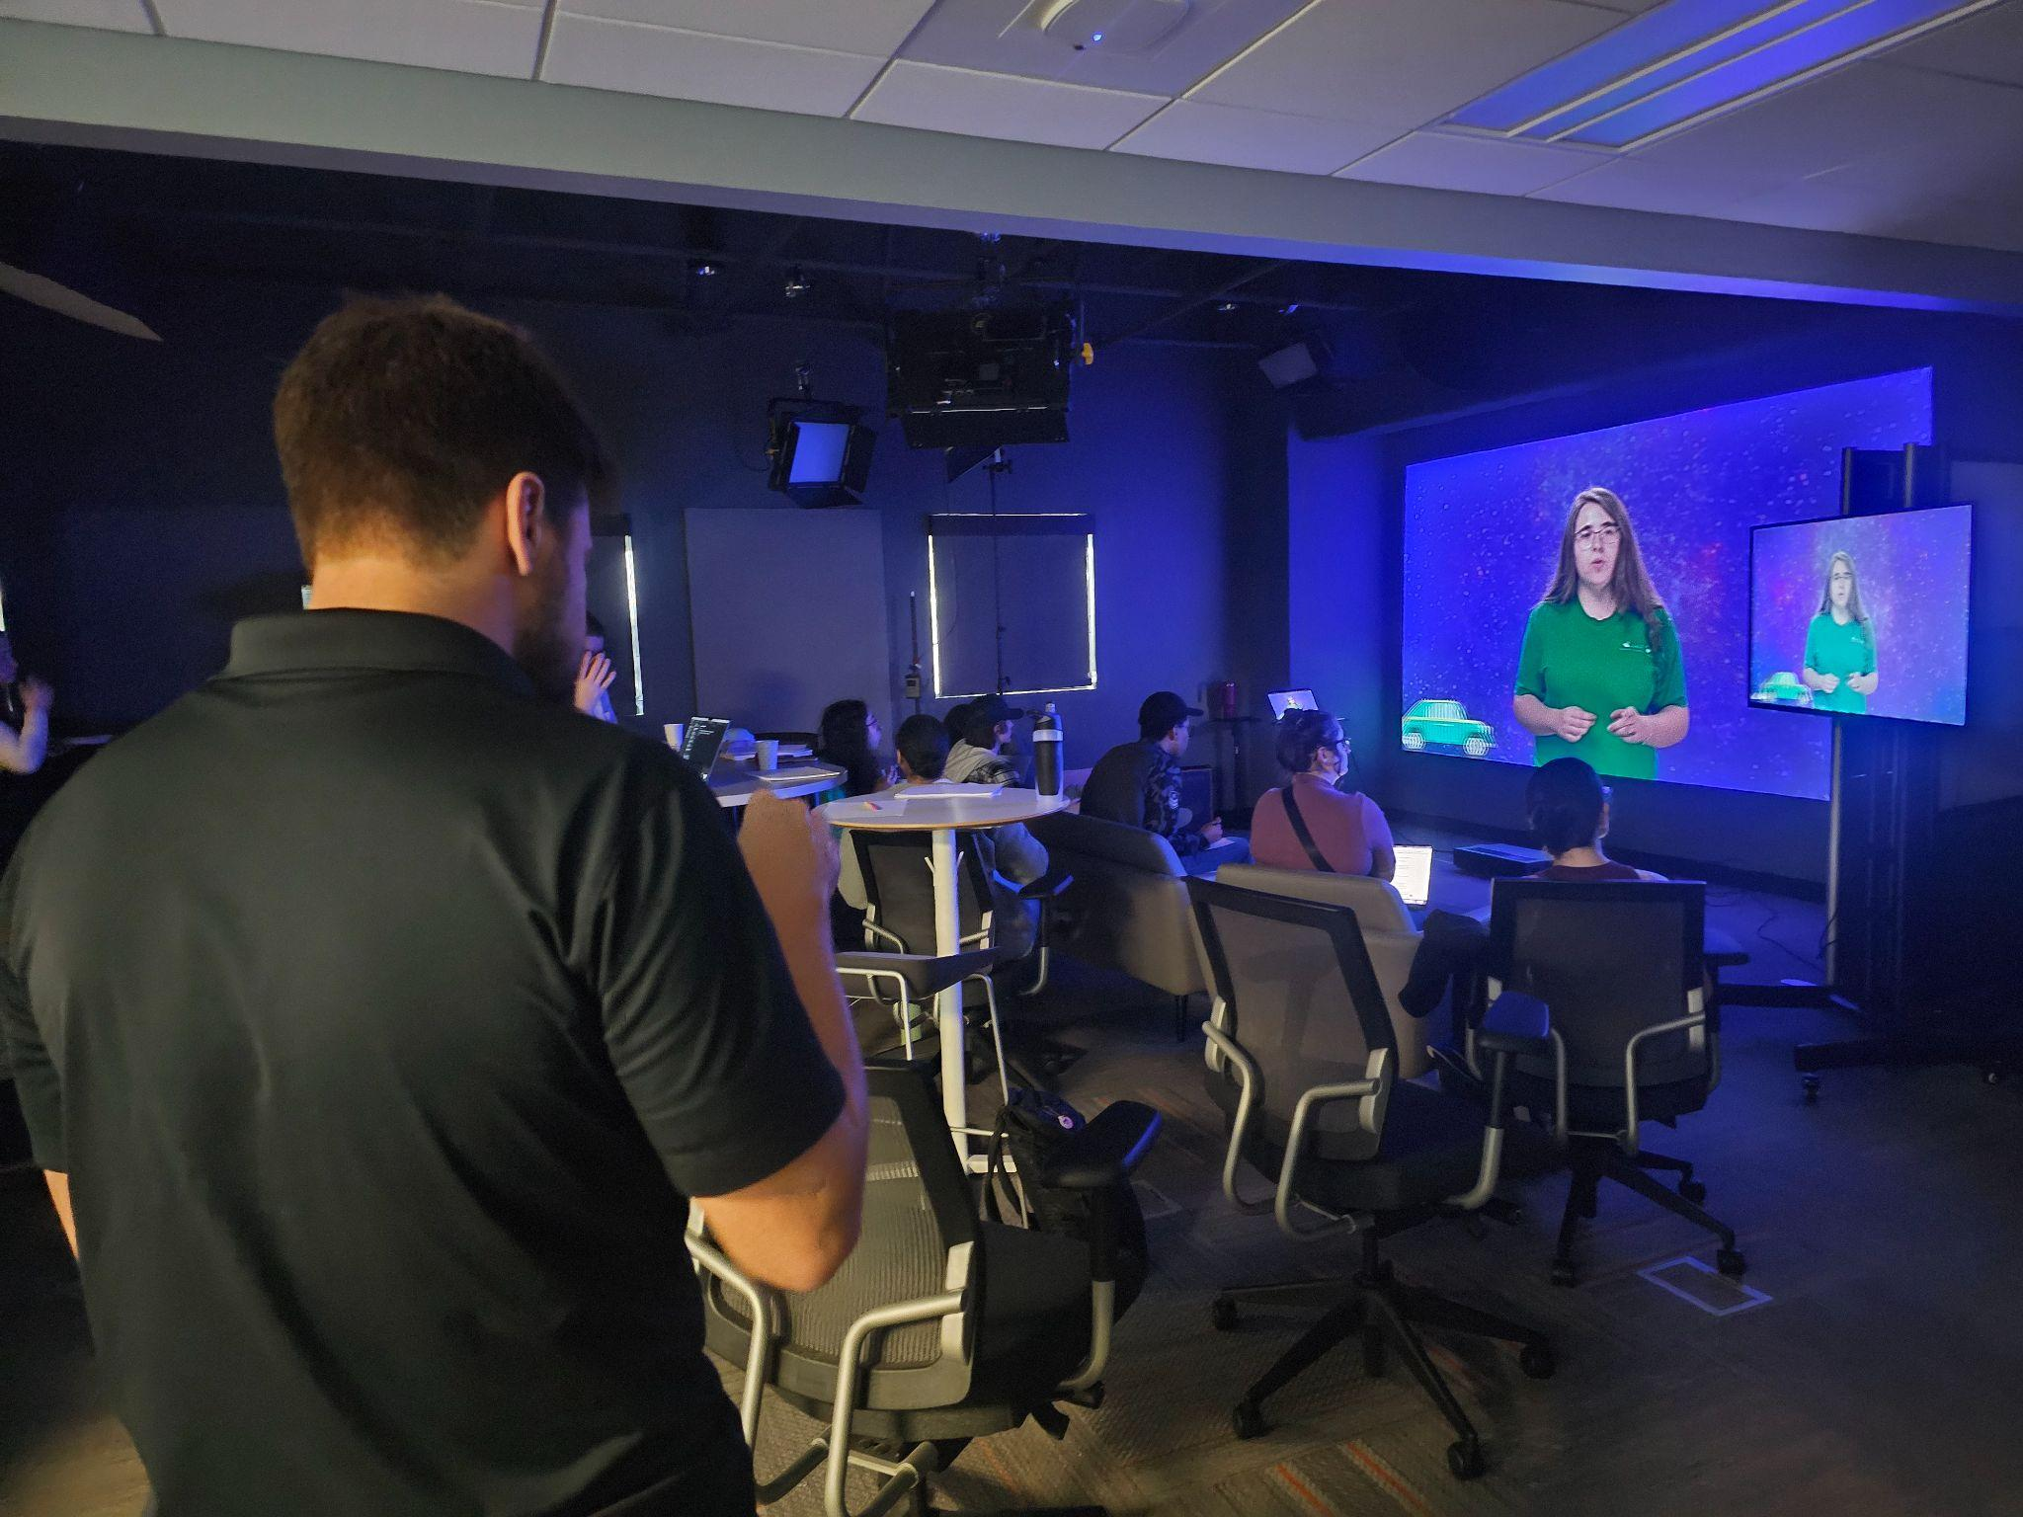
Peer Review
Notes:
-in person review
-students, professors, industry professionals, and an astronaut was included in the review process

Slide 10
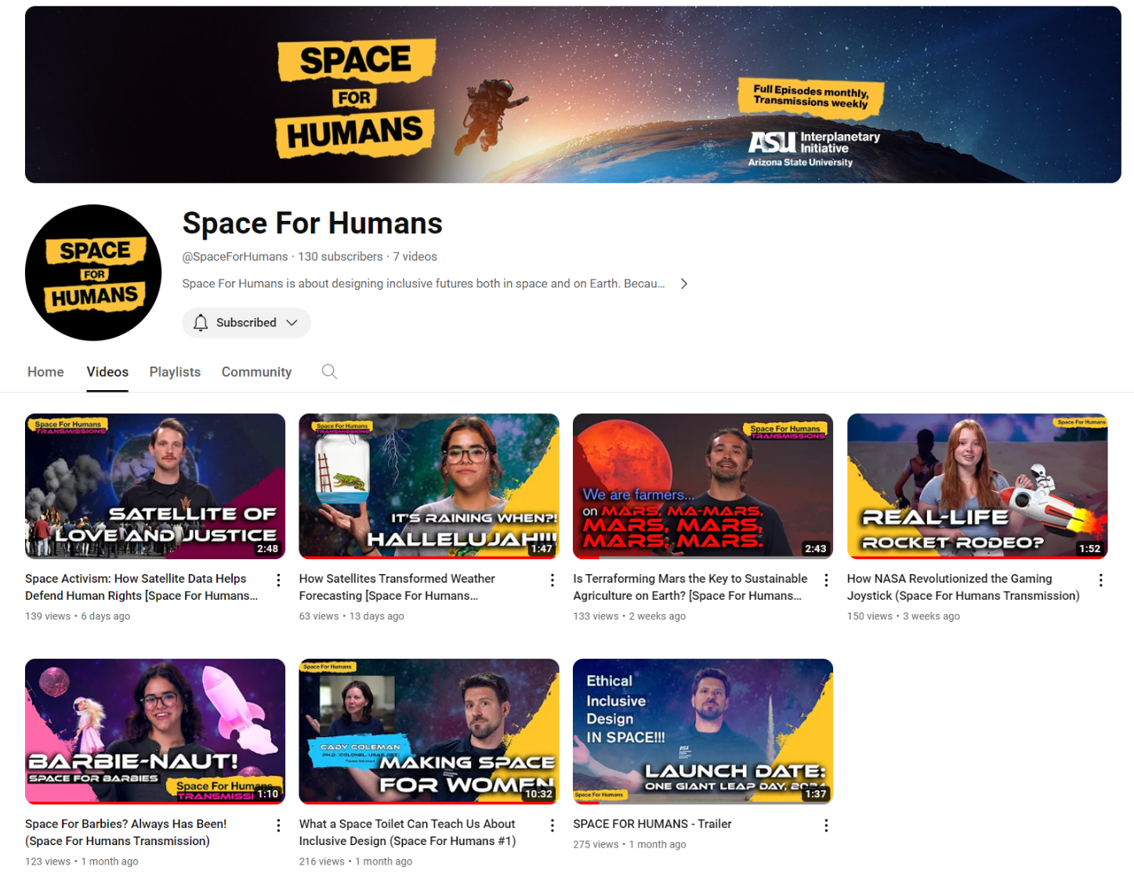
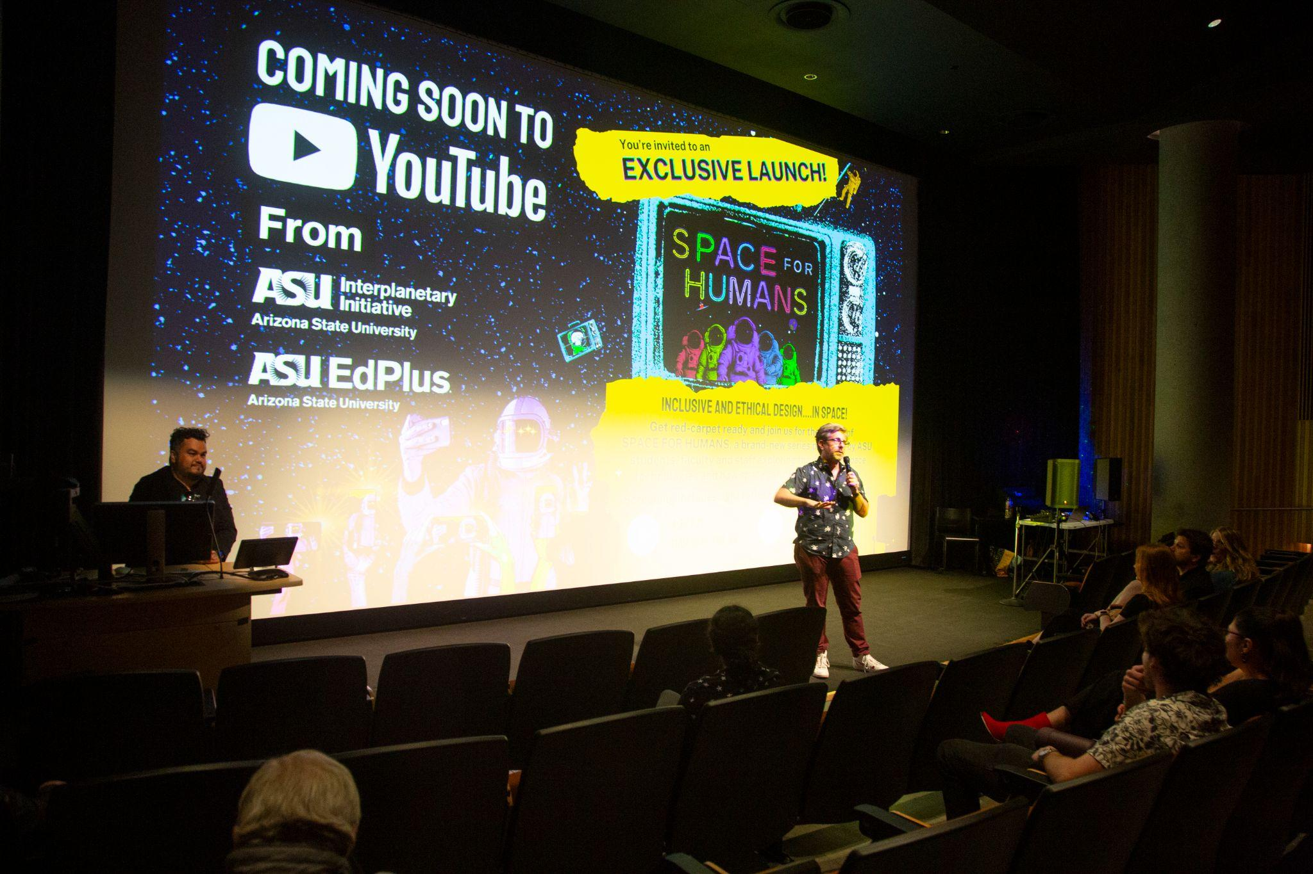
Publish Videos
Notes:
-weekly videos (thursday)
-65 people came to the screening

Slide 11
Results
Results
Recruited
Astronaut: 1
Mission Lead: 1
Staff: 3
Professors: 5
Students: 15
Statistics
The channel has grown 2 times the average amount of a normal YouTube channel
Metrics (1 Month)
Subscribers: 130
Total views: 1098
Average views per video: 157
Total likes: 98
Average likes per video: 14
Featured
NPR
Desert Botanical Gardens
Publishing (1 Year)
Long Videos: 24
Transmissions: 36

Slide 12
Future
Expand collaborations with ASU programs, faculty, and students
Connect with opinion leaders in the space communication community
We have committed to 52 weekly videos and will produce more seasons once we get approval
Increase subscriber, views, and like count

Slide 13
Acknowledgements
Dr. Eric Stribling
Ricardo Leon
Amanda Kehrberg
Isabelle Giunta
ASU Interplanetary Initiative
ASU EdPlus

Slide 14
Thank you

